Slide 1
CIVE7100 Global Energy consumption Analysis
By Srivathsav Mitnala

Slide 2
Introduction
Fossil fuel resources are depleting and there has been an increased consumption of these resources in the last several years
To counter this, there has been a lot of research being conducted to find alternative resources in order to conserve fossil fuels
In this analysis, I intend to see the variation of consumption of these different resources in the US and across the globe.

Slide 3
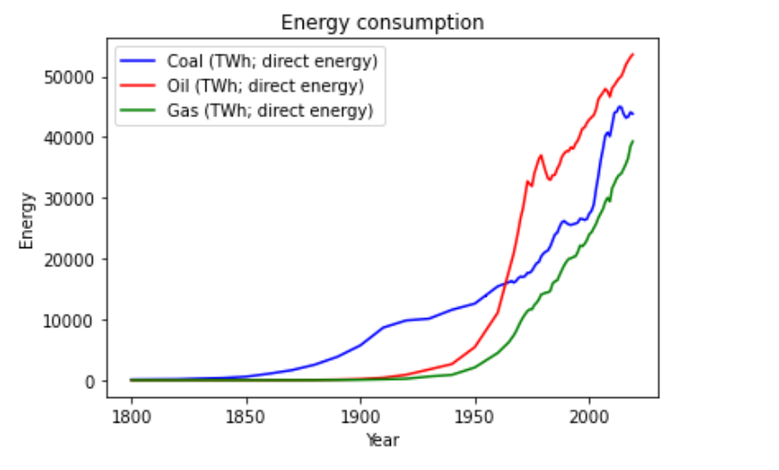
Analysis of fossil fuels
Coal was the most prominently used fossil fuel in the early 1800s.
Oil has now taken over as the resource with the most usage as far as the consumption is concerned.
There has been a steady increase in the usage of gas as a resource whereas, the other resources have seen sudden changes at different points in time.

Slide 4
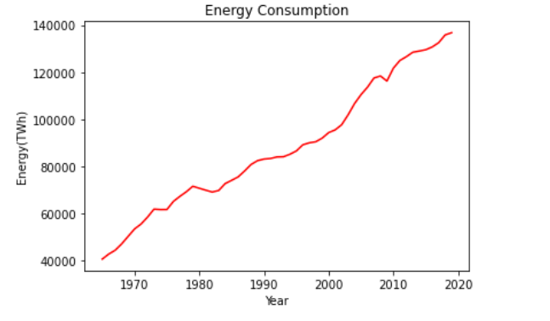
For this analysis, I am using the data between 1965 to 2019.
As it can be seen from the plot, there has been general overall increase in energy consumption across the years.
There is a slight increase in consumption in 1980’s which could be due to the fact that many innovations in the technological domain take place before and during this period.
A slight decrease in the consumption can be seen prior to 2010’s , this can be owed to the countries realizing the potential in alternative resources like solar energy, wind energy etc.

Slide 5
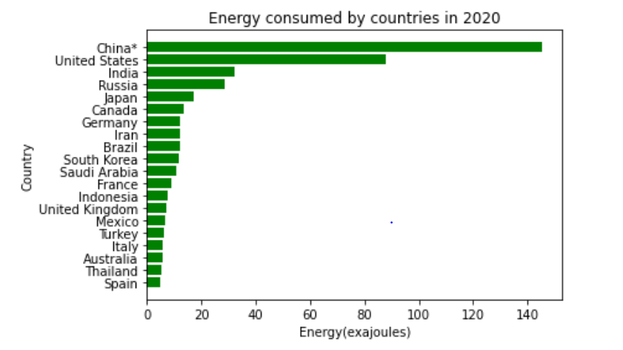
Which Country consumes the most?
In 2020, there was a 4% decrease in energy consumption owing to the lockdown and lesser usage of transportation.
China consumed the most energy in 2020.

Slide 6
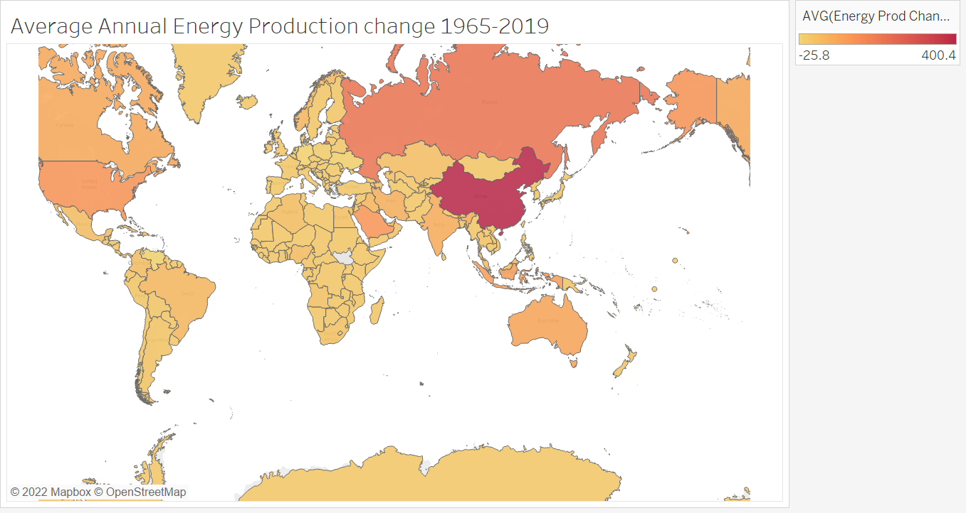
Energy Production

Slide 7
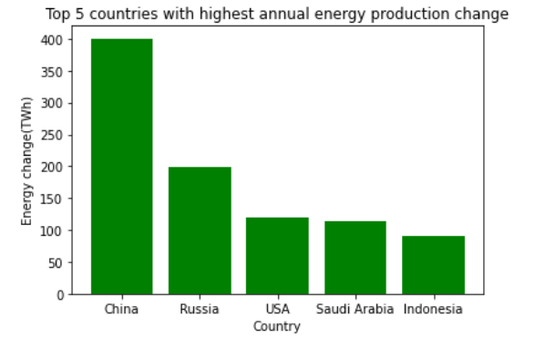
It represents the average annual change in energy production via fossil fuels.
China has the highest average change in energy production annually, which is a proof of the fact that it is the country that consumes the most energy from fossil fuels.

Slide 8
Next Steps and Future Scope
Identify factors and collect data for each country.
I would be performing time series analysis on the data between 1965-2019 and use performance metrics to determine the best model and predict accordingly.
I am going to perform correlation analysis to determine the factors that contribute to higher/lower consumption of energy through fossil fuels.
The main use case for this project would be about how it can be applied to a particular industry in a country to make processes more energy efficient.

Slide 9
Data Sources
https://www.kaggle.com/code/yomnanasseryounis/energy-consumption-data-visualization-tutorial/data
https://www.statista.com/statistics/263455/primary-energy-consumption-of-selected-countries/#professional
https://ourworldindata.org/energy

Slide 10
THANK YOU!

